Slide 1
Water Report & News Classification using BERT Method
IAL 620 – Text mining & natural Language Processing
By – Pradnya patil

Slide 2
Introduction -
In last years, water quality has been threatened by various pollutants and some environmental issues.
Now a days due to global warming and high amount of pollution, we are getting new information about environment and that is accessible to public on every second, the information such as reports, news, books, articles, etc.
Using the water report and news, I am classifying the data into different category and make the decision more efficiently.

Slide 3
Research Questions
Exploratory Data Analysis on the raw downloaded dataset along with text cleaning and transformation.
Explain different methods to analyze text and extract features that can be used to build a classification model
Classify water news and Reports based on subject text using Machine Learning Models
Predict the probability of the different target variables using the classification.
Do sentiment analysis of news and reports related to the water problems based on environmental issue.

Slide 4
Data Description -
Collected the from Kaggle
The dataset contains 2 files so far - an English-language dataset from the English-language edition of the book,
where the co-author, and a Ukrainian-language dataset from a separate Ukrainian-language edition of this book.
These datasets contain approximately 95% of the same information.
(100, 6)

Slide 5
Data Description Table -
Attribute | Data Type | Description
text | String | One or more sentences from reports or news
env_problems | Integer | Is the text about an environmental problem? (0 or 1)
pollution | Integer | Is the text about environmental pollution? (0 or 1)
treatment | Integer | Is the text about treatment plants or environmental technologies? (0 or 1)
climate | Integer | Is the text about climatic indicators? (0 or 1)
biomonitoring | Integer | Is the text about biological, biotic monitoring in water or in a river basin? (0 or 1)

Slide 6
Data Analysis
News, reports, and articles are the most important unstructured data sources now a days along with the structured dataset.
In the news, reports people describe about the health, food, world, environment, travel, and every topic.
From this unstructured data form, we can in out the different result and do the data analysis and help to the world in different aspects.
Here are some of my analyses about the news and reports from my Exploratory data analysis.

Slide 7

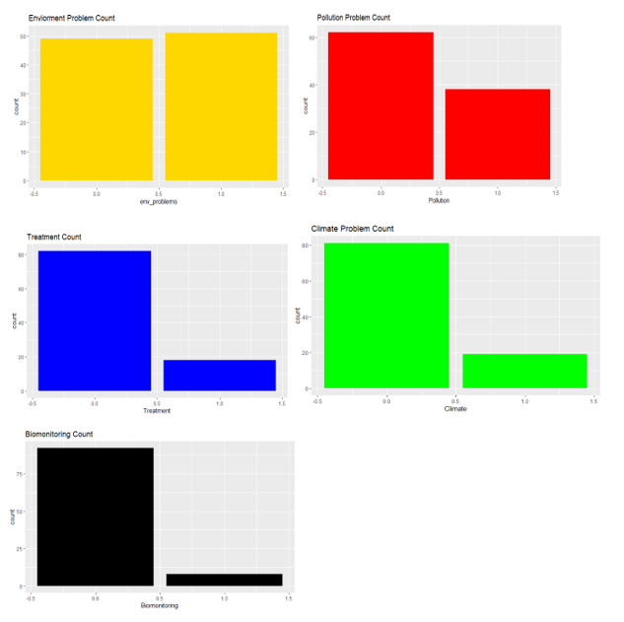
Results -

Slide 8
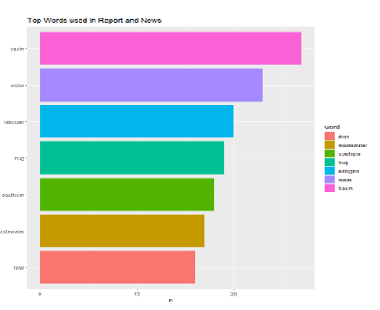
Results -

Slide 9
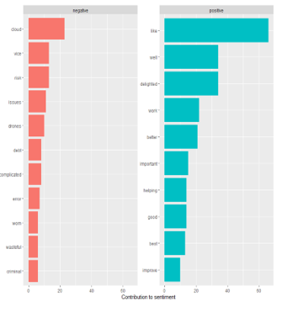
Results -

Slide 10
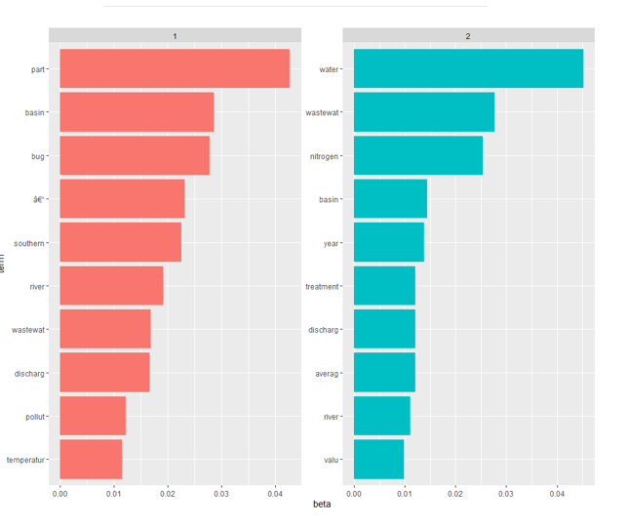
Results -

Slide 11
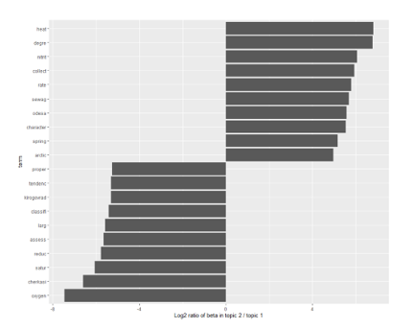
Results -

Slide 12
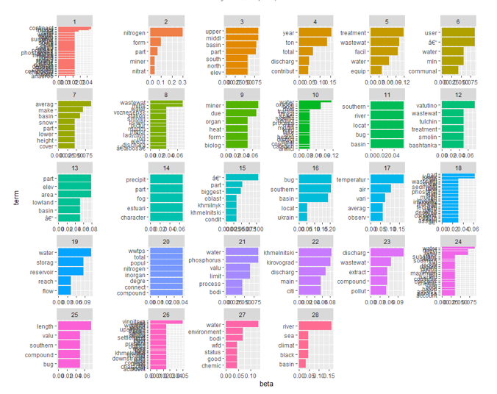
Results -

Slide 13
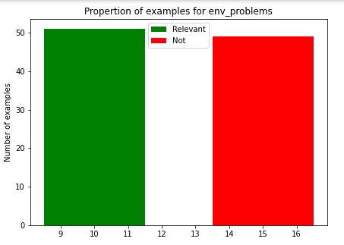

Classification Result -

Slide 14
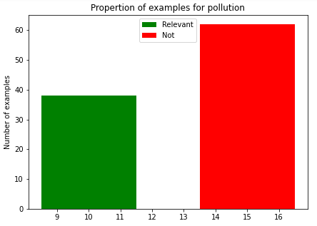

Classification Results -

Slide 15
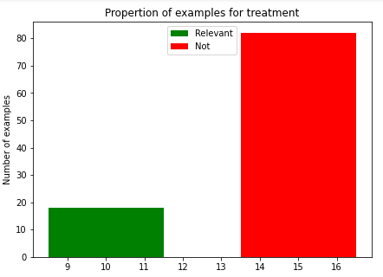

Classification Results -

Slide 16
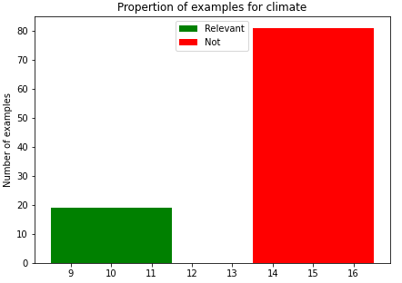

Classification Results -

Slide 17
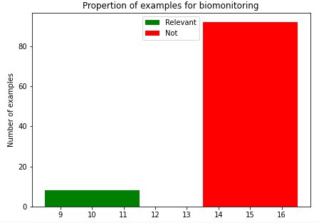

Classification Results -

Slide 18
Conclusion -
Did some data wrangling and scrubbing and find out the most frequent words that has been used in the reports and news.
From the Sentiment analysis learned how negative and positive words affected on our analysis.
Using the word frequencies, N-gram an word correlation understood the concept and the relation between the words that has been used in text format.
Using the BERT classification model got the best score (0.96) for the climate variable and the got the highest prediction for the same variable which is (0.975)

Slide 19
Reference -
https://www.kaggle.com/vbmokin/nlp-reports-news-classification
https://towardsdatascience.com/text-analysis-feature-engineering-with-nlp-502d6ea9225d
Github URL for code: https://github.com/Pradapatil/IAL62_NLP_-_TM

Slide 20
Thank You !

